Slide 1

Optimizing Nightly Rates for Airbnb Philadelphia
By Armand Debray and Hark Chadha

Slide 2

Executive Summary: Setting
the Scene
1
Airbnb's Role
2
Philadelphia: A Prime Location
Significant player in the short-term rental market.
Rich history, cultural attractions, high demand for rentals.
3
Pricing Challenges
Hosts struggle to balance occupancy and revenue.

Slide 3
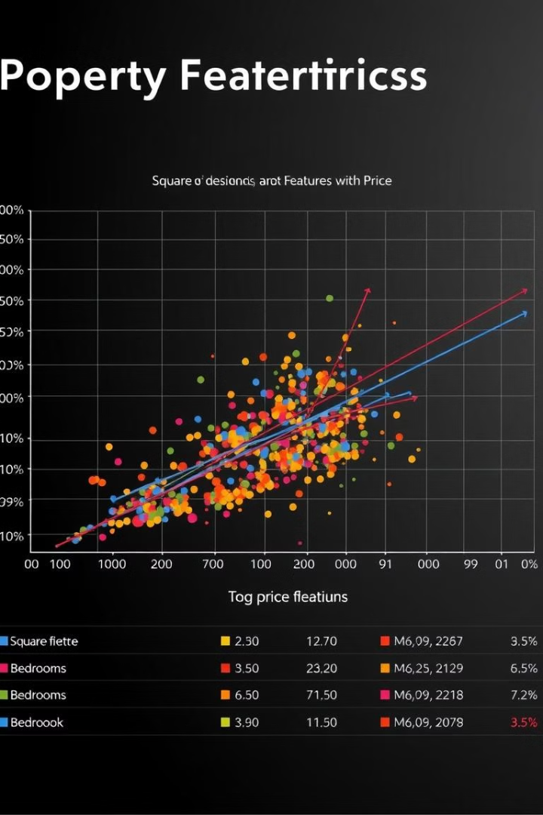



The Story of Rental Pricing
The Problem
Pricing is complex: property, location, reviews, demand.
Challenges
Lack of tools for analysis, competitor rates, seasonality.
Solution
Predictive algorithm for optimal nightly rate recommendations.

Slide 4
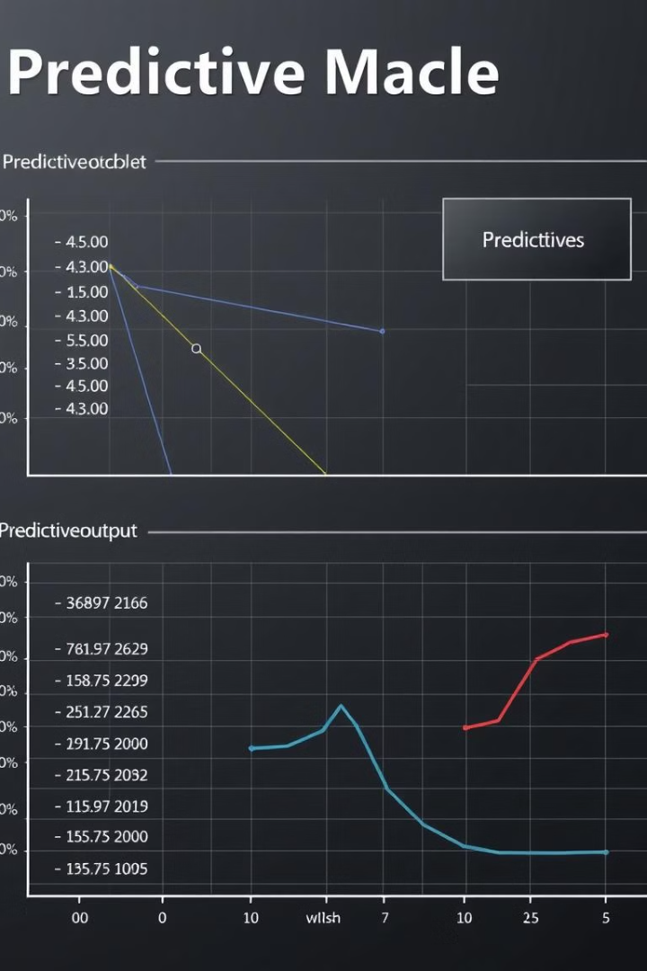
Why an Algorithm?
Automation
Accuracy
Eliminates manual effort in analyzing pricing factors.
Leverages historical data and market trends for precise recommendations.
Adaptability
Dynamically adjusts to changes in demand and competition.

Slide 5
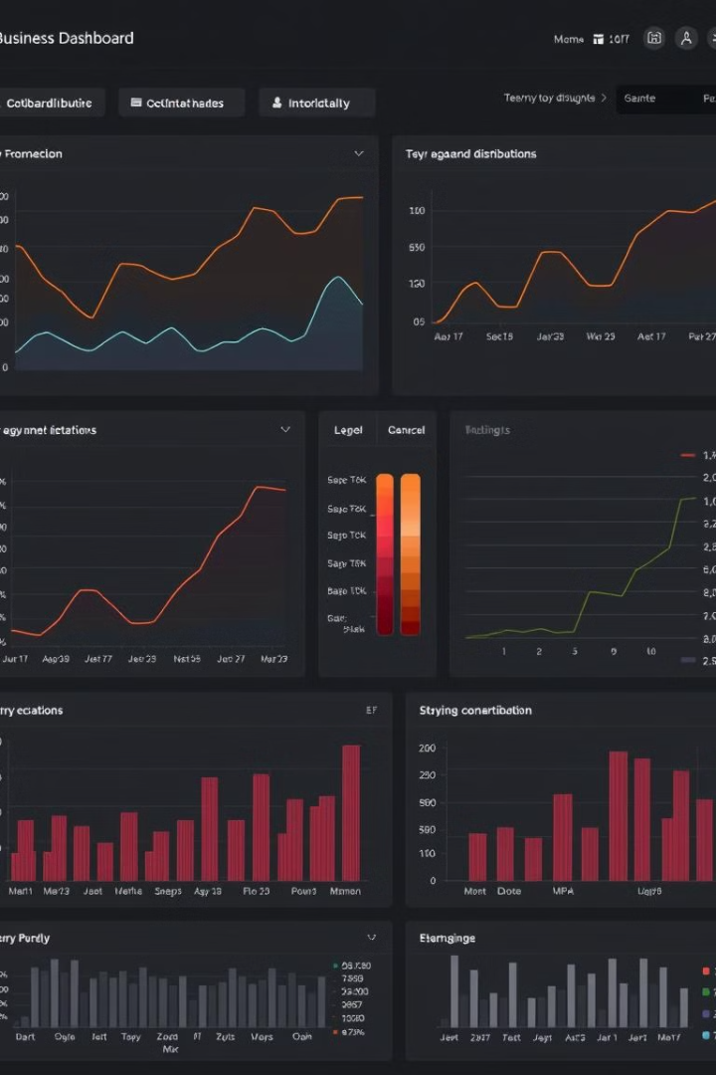




Dataset and Summary Statistics
Property Characteristics
Availability Metrics
Bedrooms, bathrooms, max guests, cleaning fees.
Booked days, available days, average listed prices.
Neighborhood Demographics
Host Quality
Superhost status, reviews, cancellations.
Population, housing units, local demand.

Slide 6
Data Cleaning and Preprocessing
Irrelevant Data Removal
Missing Value Handling
Outlier Removal
Scraped dates and previous period data are irrelevant.
Median imputation for numerical features, mode imputation for categorical features.
Using interquartile range (IQR) for Nightly Rate outliers.

Slide 7

Model Selection and Tuning
1
Baseline Model
2
Hyperparameter Tuning
Random Forest Regressor with default parameters.
RandomizedSearchCV with key parameters like n\_estimators, max\_depth, min\_samples\_split.
3
Final Model Performance
R² = 0.77, MAE = $78.29, RMSE = $124.35.

Slide 8




Feature Importance Analysis
Rating Overall
1
Directly correlates with property quality.
Number of Reviews
2
Reflects demand and customer experience.
Max Guests
3
Influences pricing through capacity.
Bedrooms
4
Larger properties command higher rates.

Slide 9
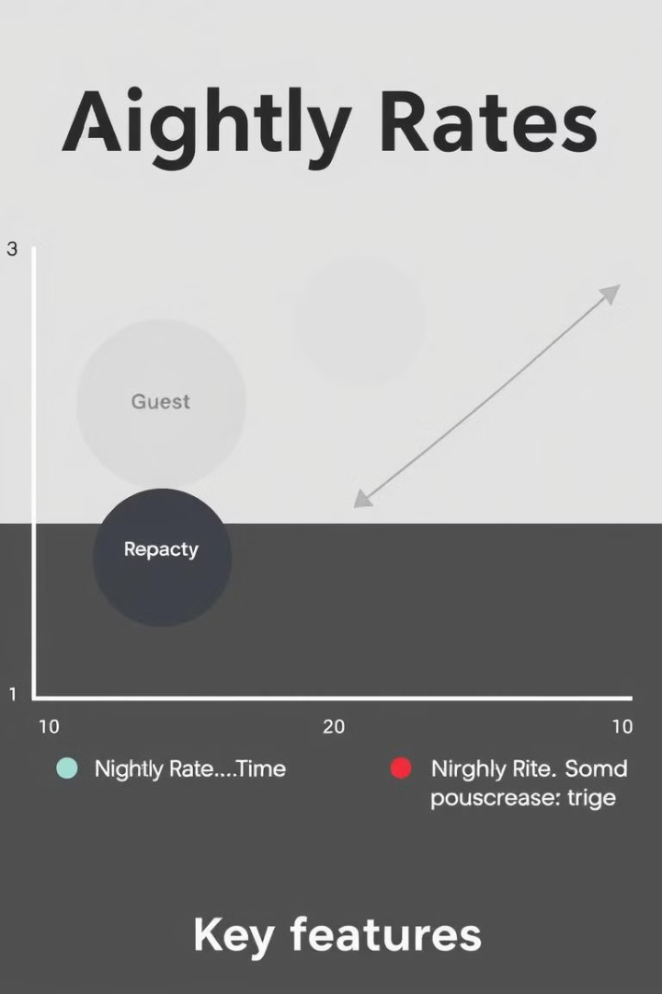



Results and Interpretation
Higher Ratings & Reviews
Fetch consistently higher rates.
Guest Capacity & Size
Crucial roles in pricing decisions.
Robust Model
Hyperparameter tuning, cross-validation, stability.

Slide 10
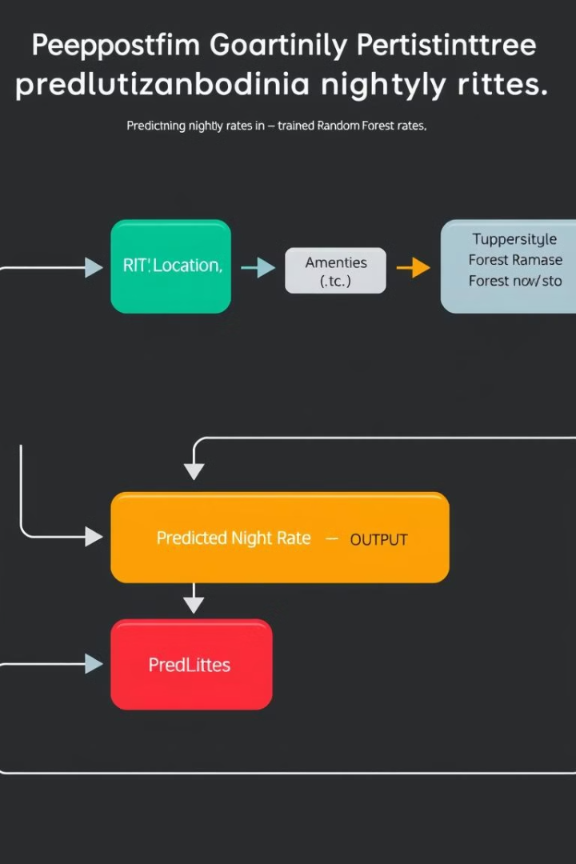
The Algorithm in Action
1
Input: property details (ratings, features, location)
2
Processing: data preprocessed (scaling, encoding)
3
Output: optimal nightly rate predicted by model.

Slide 11
Implications for Business
Hosts
Airbnb
Competitors
Actionable insights for improved bookings and revenue.
Potential integration for automated host pricing recommendations.
Demonstrates how machine learning enhances dynamic pricing strategies.

Slide 12
Conclusion and Future Directions
Summary
1
Robust model, strong performance metrics, key predictors identified.
Implications
2
Data-driven tool for hosts, increasing competitiveness and revenue.
Future
3
Expansion to more cities, incorporate external data, real-time pricing.

